Slide 1
PHP
UNIVERSITAS MUHAMMADIYAH SURAKARTA
YOGIEK INDRA KURNIAWAN

Slide 2
INTRODUCTION
PHP = PHP : HYPERTEXT PREPROCESSOR

Slide 3
Preparation
Laptop / PC
Web Server
Web Browser
Text Editor

Slide 4
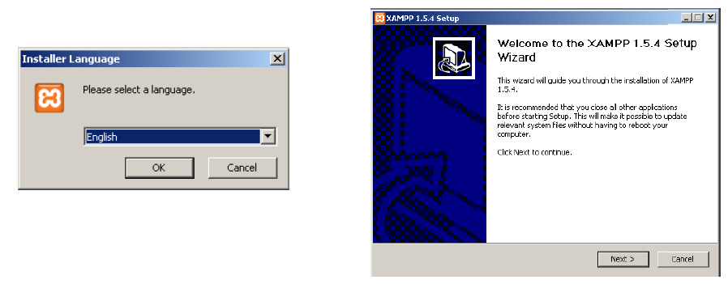
Installation

Slide 5
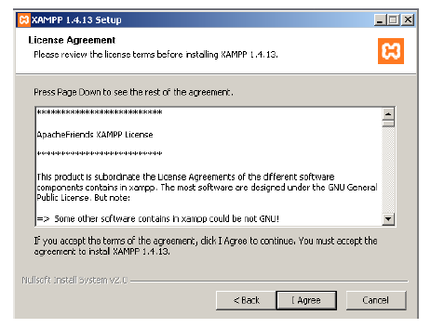
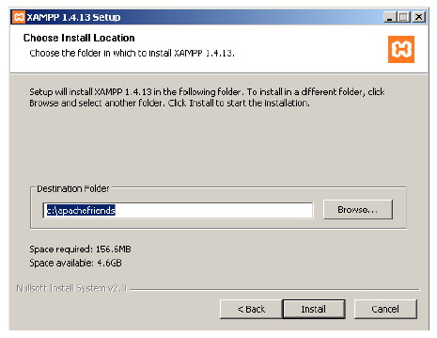
Installation

Slide 6
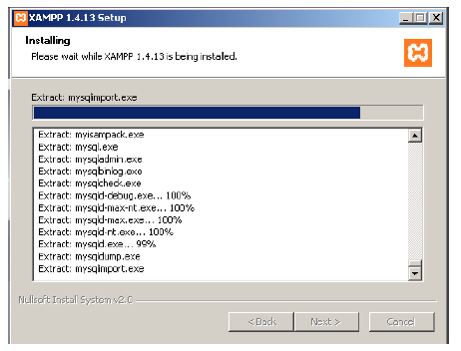
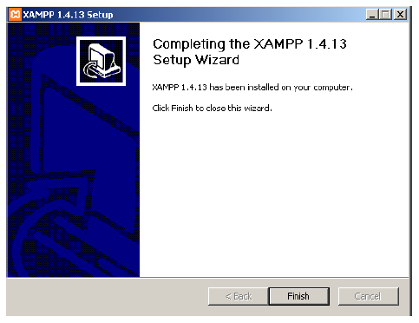
Installation

Slide 7
PHP
<?php ............... ?>
<? .......................?>

Slide 8
Type Something
echo “your_word”;
Example :
<p>
This is from web browser!!
<?php
echo “This is from Server …”;
?>
</p>

Slide 9
Comment
// Comment 1 line
# Comment 1 line
/* Comments with
many line */

Slide 10
Data Type
Boolean
Integer
String
Array
Object
NULL
Float / double
Resource

Slide 11
Varriable
$angka = 0;
$nama = ‘sule’;
$tgl=date ("d M y");

Slide 12
Array
$variable=array(nilai1,nilai2,nilai3);
$variable[]=nilai;
Accessing
$variable[indeks]
Indeks start from 0

Slide 13
Operator
$a + $b –($c * $a) / ($b % $c)
$a && $b, $a and $b
$a || $b , $a or $b
$a xor $b
!$a
$a <> $b , atau $a != $b
$a <= $b, atau $a >= $b
++$a, atau --$a, $a += $b;
$a++
$a = “Selamat”; $a .= “Pagi”;

Slide 14
IF...Else
<?php
If( ($a == $b ) && ($a > $c) ){
echo “SAMA”;
}elseif($a > $b) {
echo “LEBIH BESAR”;
}else {
echo “LEBIH KECIL”;
}
?>

Slide 15
While....Do...
<?php
$i=0;
while($i<10) {
echo ++$i;
}
do {
echo --$i;
}while ($i>0);
?>

Slide 16
Switch
<?php
$i = 0; switch ($i) { case 0: echo "i equals 0“; break; case 1: echo "i equals 1“; break; case 2: echo "i equals 2“; break; } ?>

Slide 17

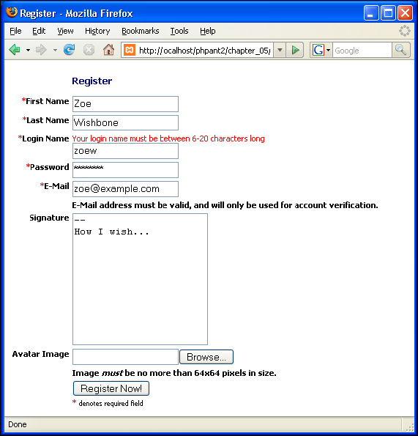
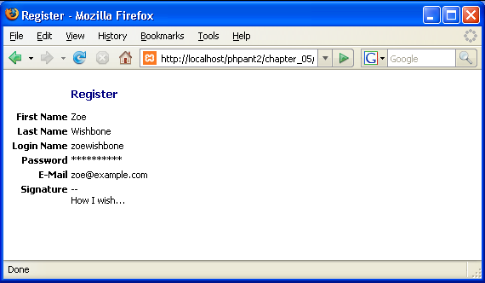
FORM MANIPULATION
Server Web
daftar.php
hasil.php

Slide 18
Basic Concept [POST]
<form
action=“reg_form.php”
method=“post”
name=“register”>
Username : <input type=“text” name=“username” />
<input type=“submit” name=“submit” value=“submit” />
</form>

Slide 19
Basic Concept [GET]
<form
action=“reg_form.php”
method=“get”
name=“register”>
Username : <input type=“text” name=“username” />
<input type=“submit” name=“submit” value=“submit” />
</form>

Slide 20
Catch Variable From Form
Method POST
$_POST[‘variable_name’]
$HTTP_POST_VARS[‘variable_name’]
Method GET
$_GET[‘variable_name’]
$HTTP_GET_VARS[‘variable_name’]

